Slide 2


About me
Based in London, UK,
Senior Manager @ EY
Microsoft MVP,
Gamer, drummer & nerd

Slide 3
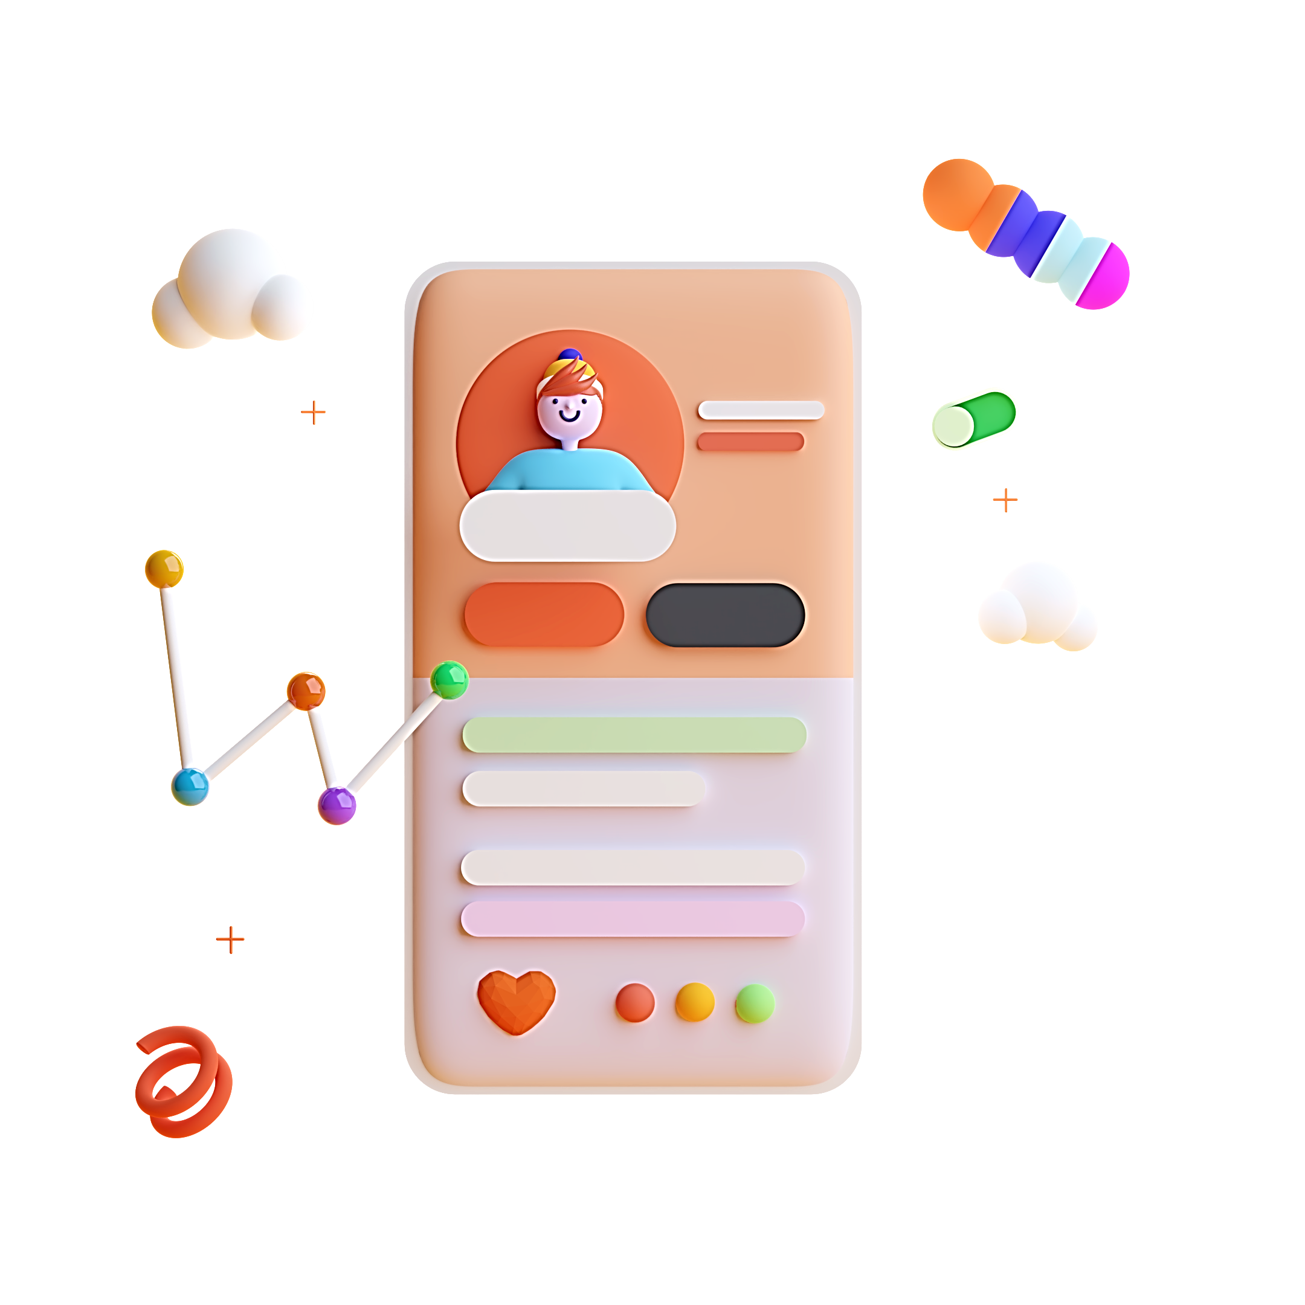
What is UI design?
Designing visual interfaces for machines and software that are memorable and meaningful

Slide 4
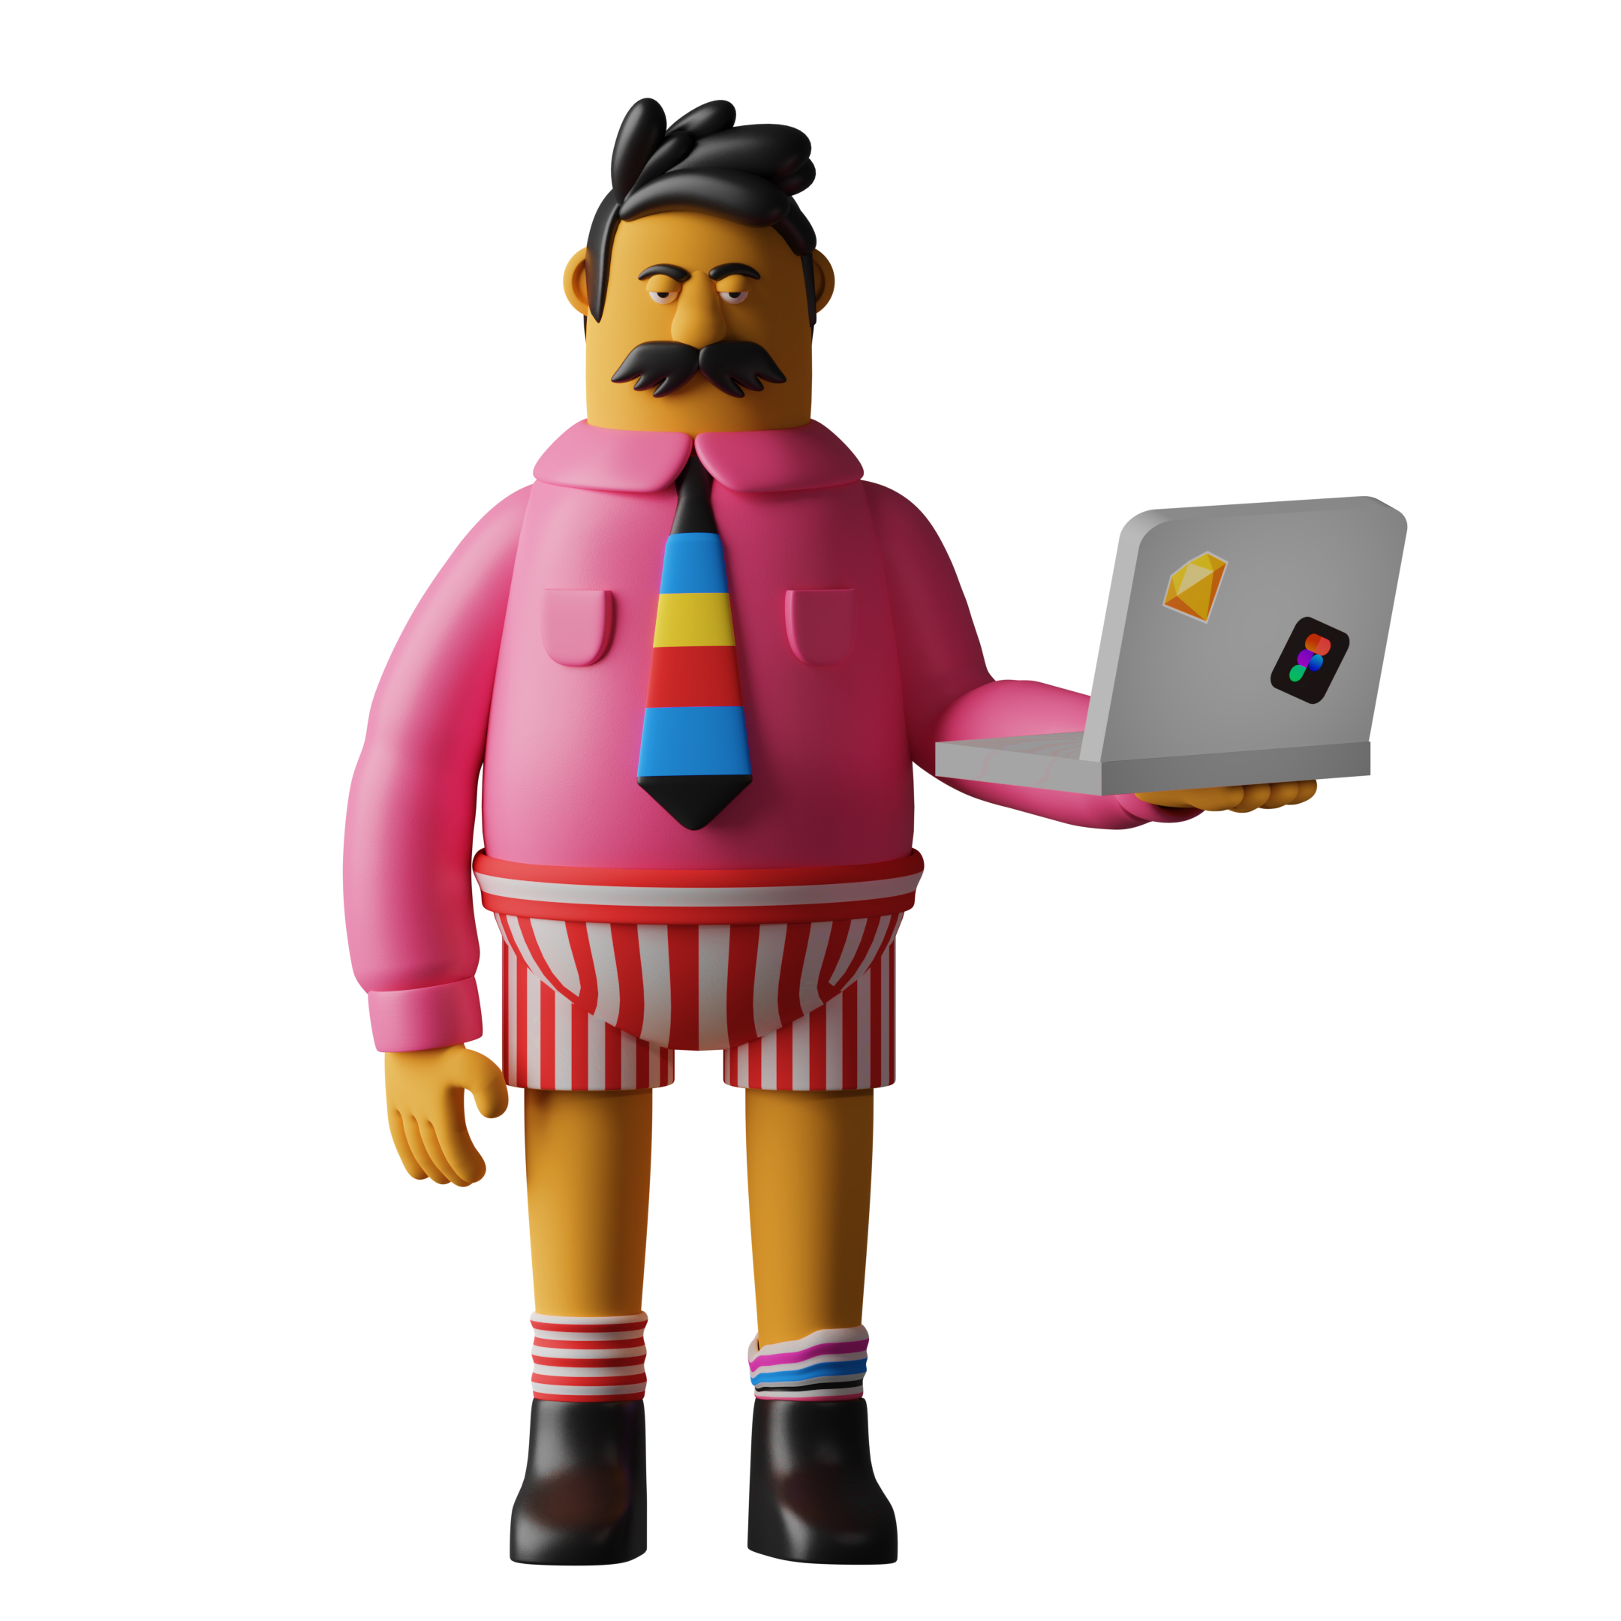
What is UI design?
‘Moving rectangles for a living’

Slide 5
What is UI design?
Designing visual interfaces for machines and software that are memorable and meaningful

Slide 6

Design principles

Slide 7
Design principles
Contrast
Repetition
Alignment
Proximity

Slide 8
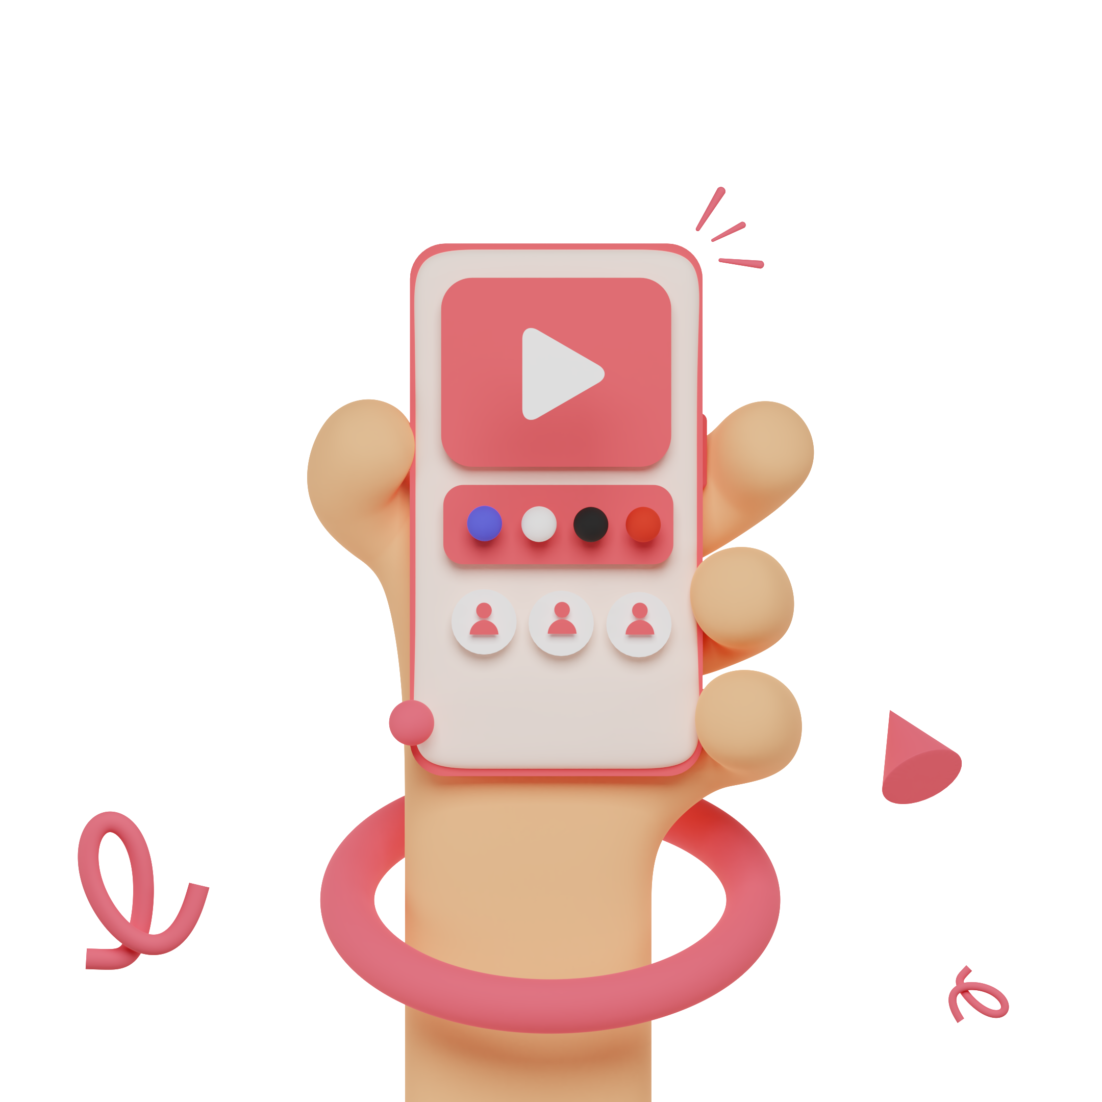
What is UX design?
to plan how something looks and works to make the activity of using it easy and enjoyable

Slide 9
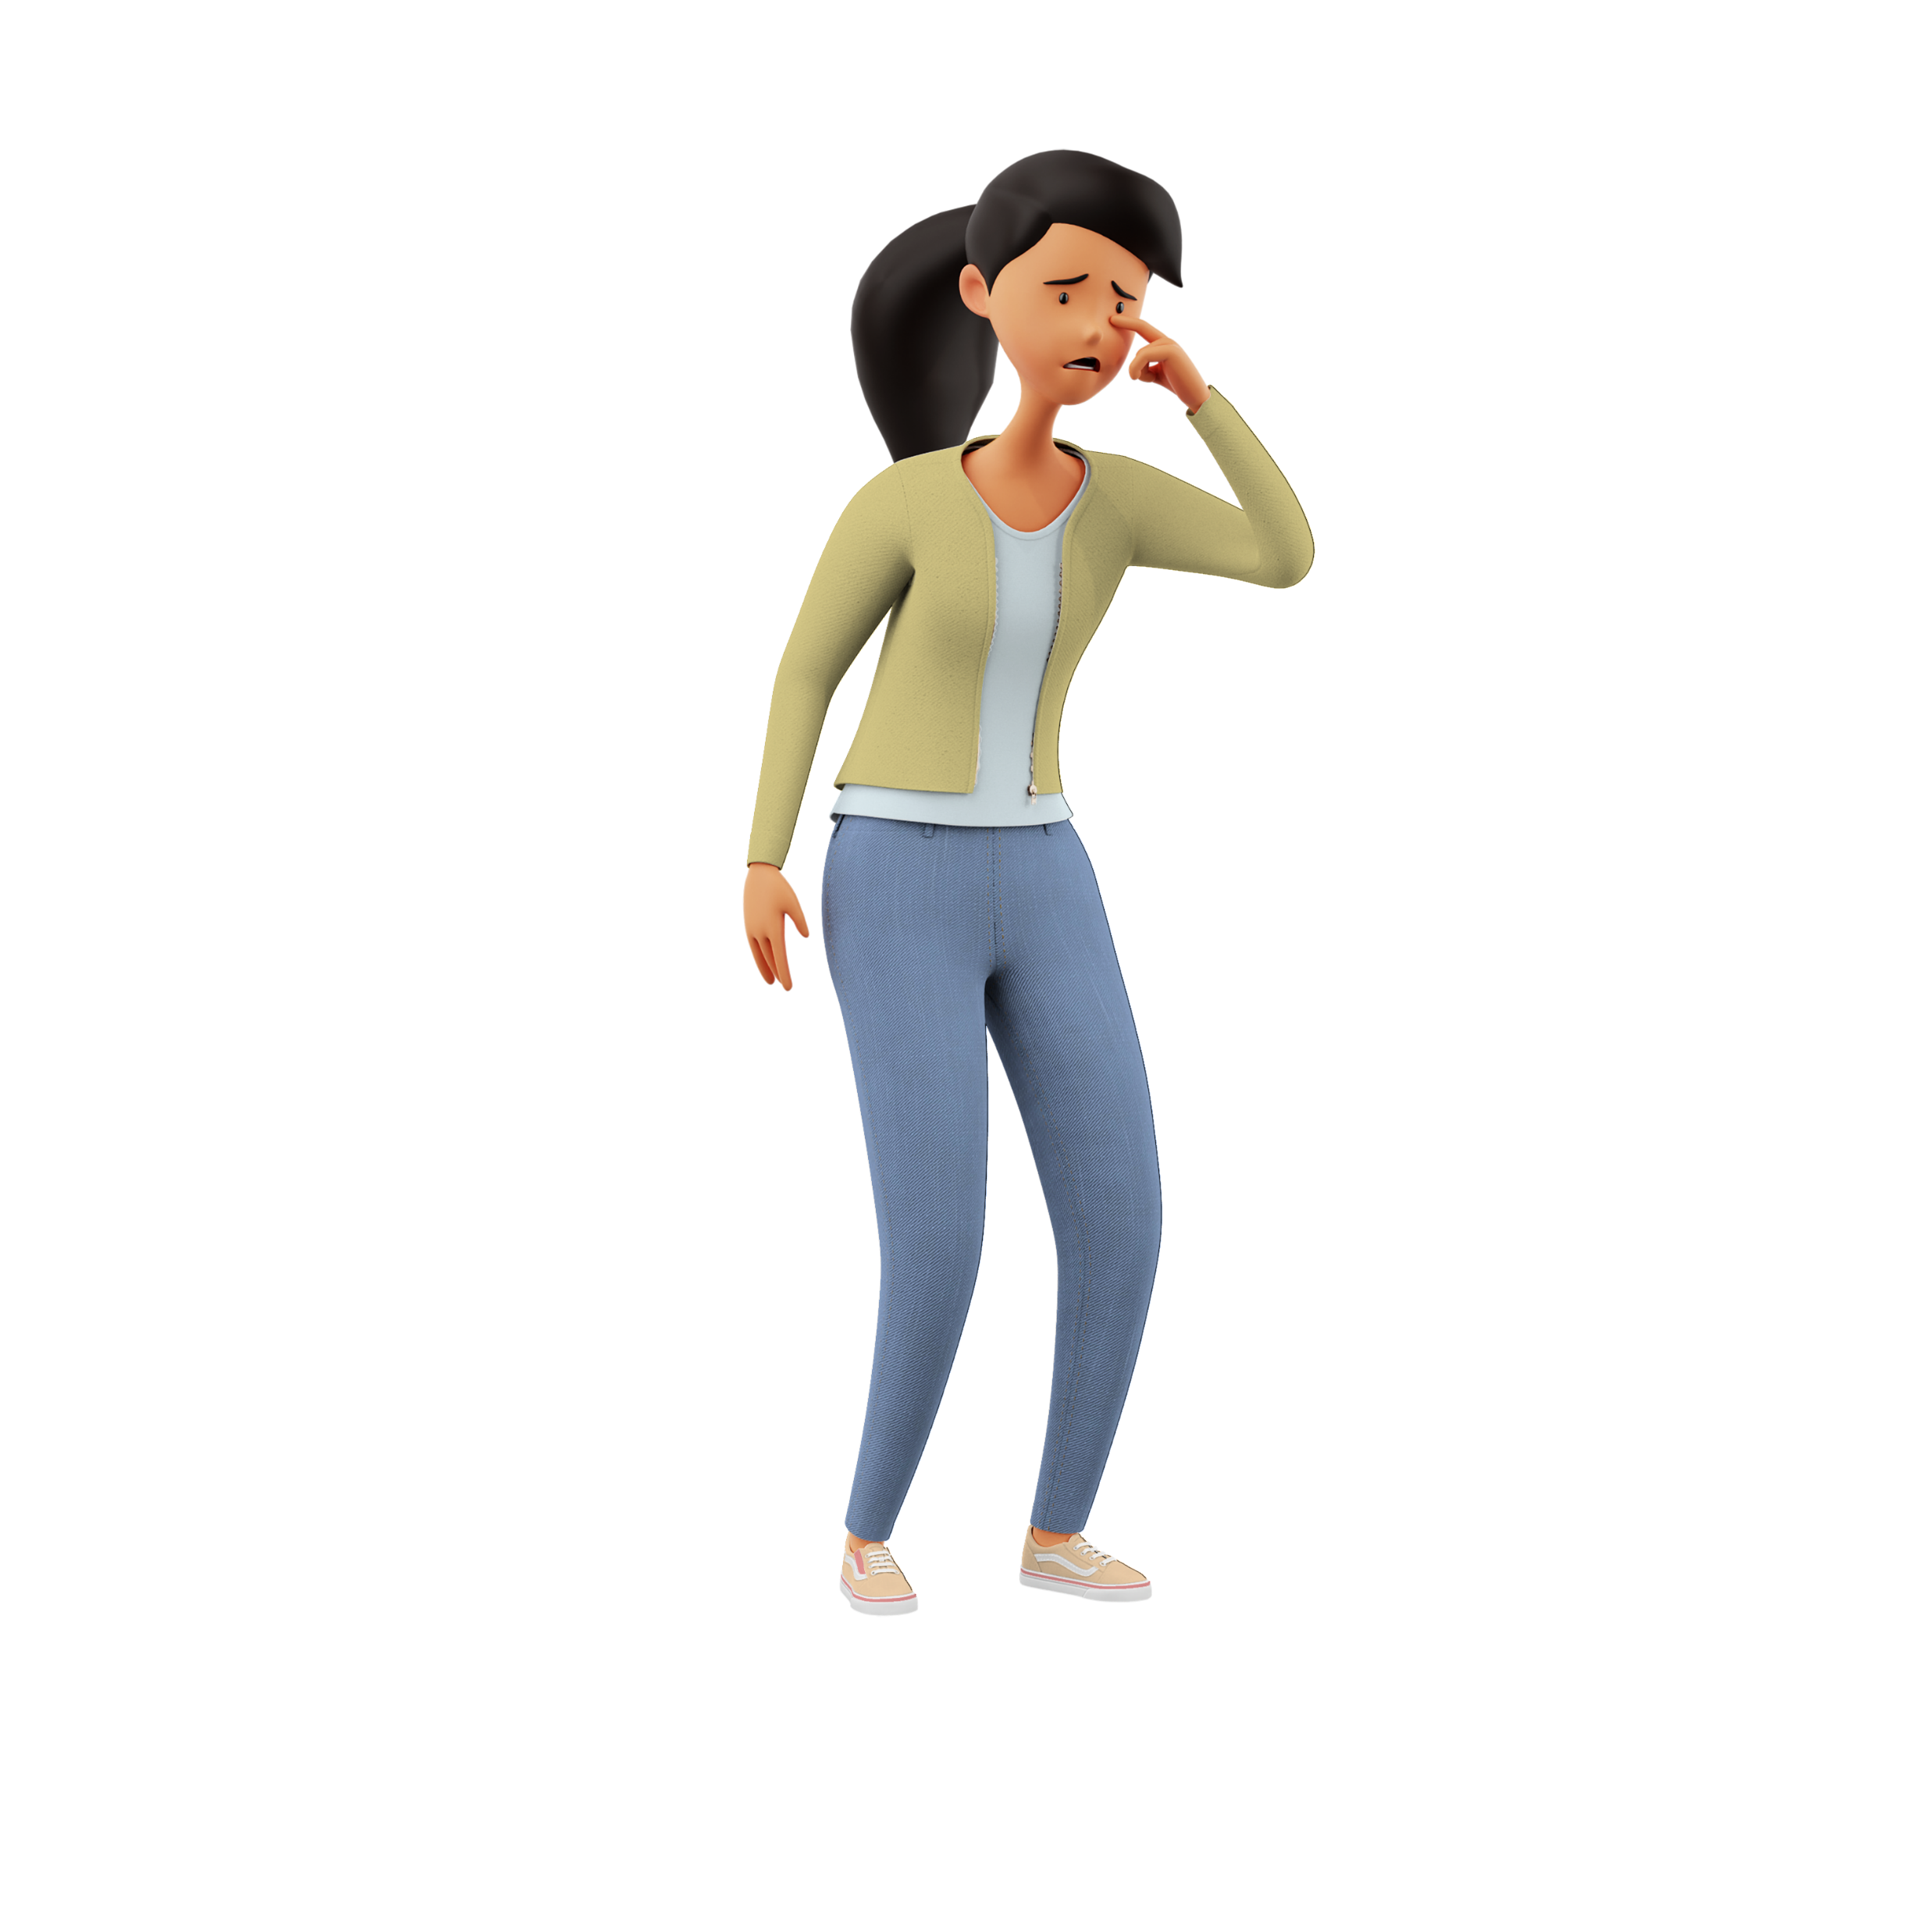
UX principles
Every course will tell you differently…

Slide 10
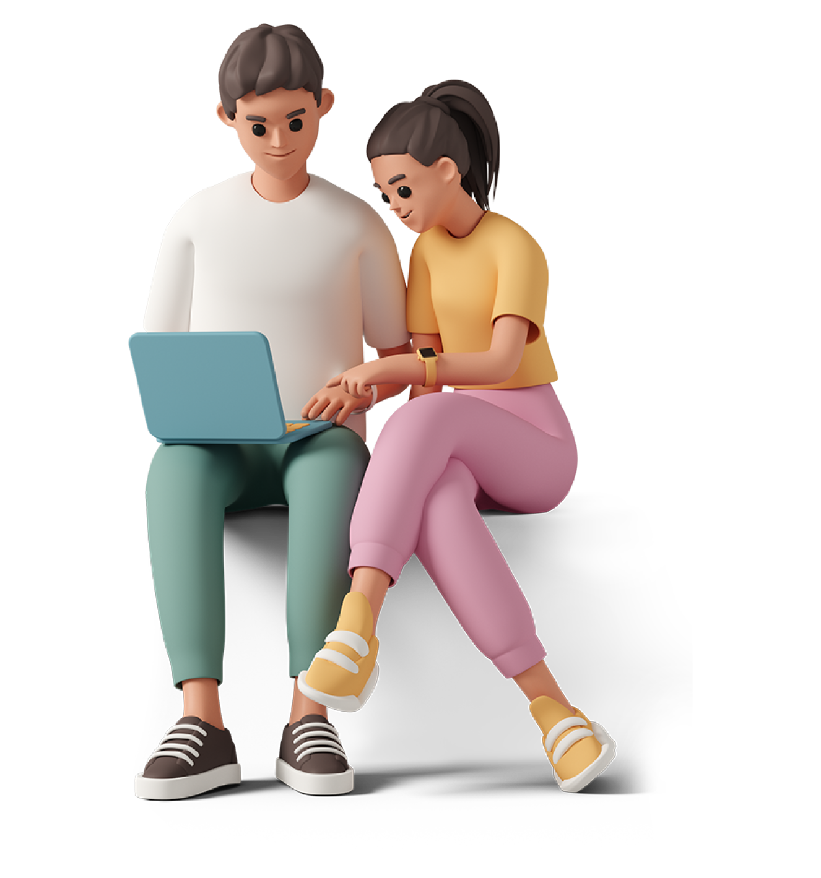
UX principles
Useful
Usable
Credible
Memorable
Learnable
Accessible
Desirable

Slide 12


HTML & CSS

Slide 13
HTML & CSS
HyperText Markup Language

Slide 14
HTML & CSS
HyperText Markup Language
standard markup language for documents designed to be displayed in a web browser

Slide 15
HTML & CSS
HTML element
<div class=“container”> </div>

Slide 16
HTML & CSS
Cascading Style Sheets

Slide 17
HTML & CSS
Cascading Style Sheets
style sheet language used to style HTML content

Slide 18

HTML & CSS
.ninja {
visibility: hidden;
color: black;
}
ruleset

Slide 19

SVG

Slide 20
SVG
Scalable Vector Graphics

Slide 21
SVG
Scalable Vector Graphics
SVG is short for Scalable Vector Grahpics, an XML-based image format for two-dimensional graphics

Slide 22
SVG in Power Apps
“data: image/svg + xml; utf8, “& EncodeUrl (“ our SVG code ”)

